Slide 1
React and Flux
Prateek Magarde
prateekmag@cybage.com

Slide 2
Index
Introduction
Setup
JS and JSX
Components
Props
State
Component Lifecycle
Specs
Events
Uni-Directional Data Flow
Assignments
Some more npms

Slide 3
INTRODUCTION
Library developed by Facebook
To develop interactive and reusable components
It can render client side and server side both.
It is using concept of Virtual DOM
Least amount of DOM manipulation

Slide 4
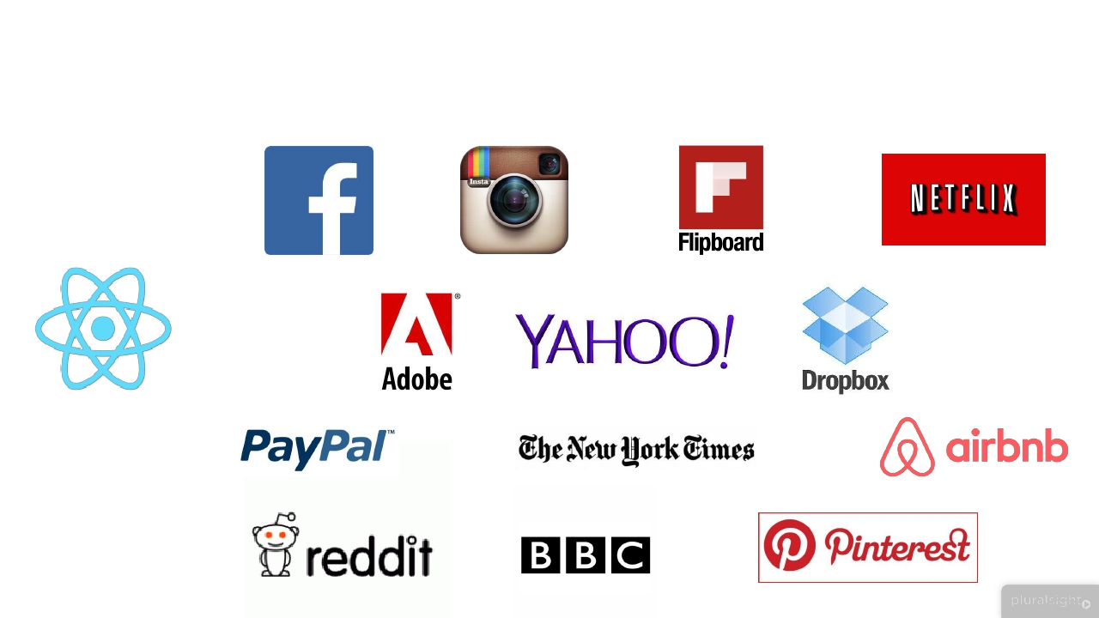
INTRODUCTION - Applications

Slide 5
INTRODUCTION - DOM
DOM – Document object model
Internal structure for browser to store and render webpages
When we update DOM the page gets re-render itself
This is expensive

Slide 6
INTRODUCTION – React updating DOM
React is using concept of Virtual DOM
It’s a internal structure of React
Mimic the browser DOM
Doesn’t do any actual rendering
Everything is done in its Virtual DOM
First it identifies what has changed > Second, Where it needs to update
This is fast

Slide 7
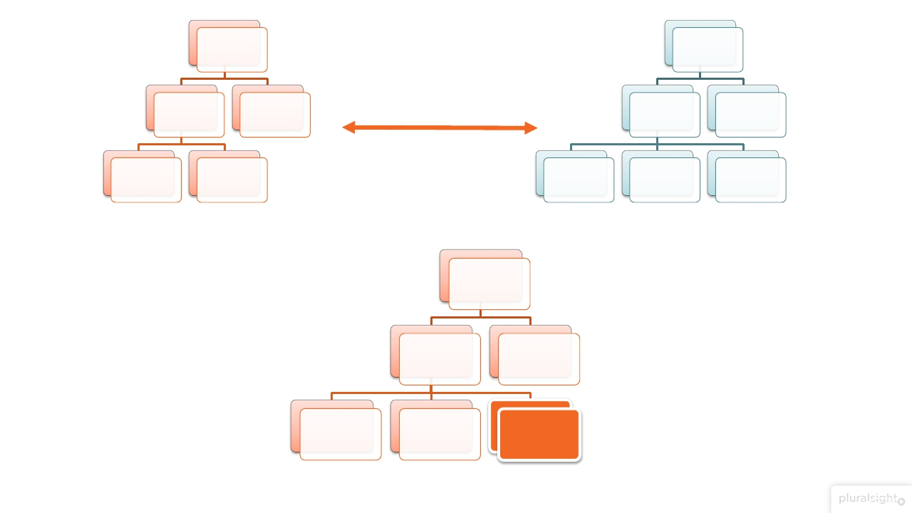

















div
div
ul
p
ul
p
Diff
li
li
li
li
li
Browser DOM
Virtual DOM
div
ul
li
p
li
li
Update and Render

Slide 8

INTRODUCTION – React updating DOM

Slide 9
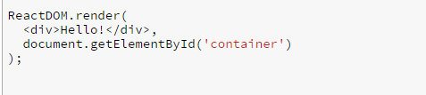
INTRODUCTION – Code

Slide 10
INTRODUCTION –JSX
JSX is an HTML like syntax which you can use with react
Easier and more efficient to create React components
By using compiler we can convert JSX into JS
We use some compilers to convert JSX into JS like Babel
Transpilation – JSX => JS

Slide 11
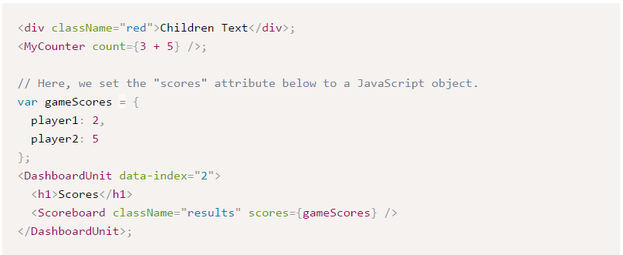
INTRODUCTION –JSX

Slide 12
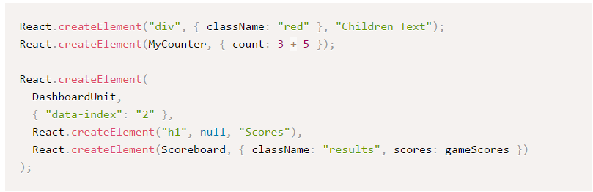
INTRODUCTION –JSX

Slide 13
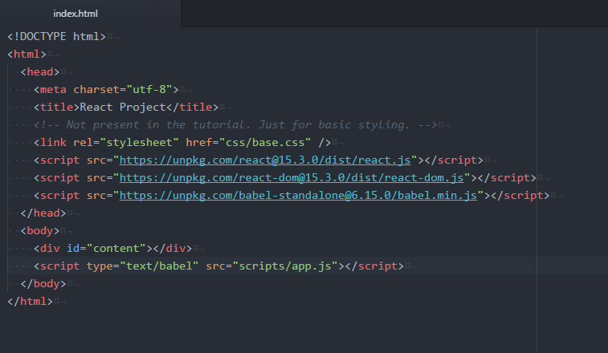
INTRODUCTION –Setup
In Index.html

Slide 14
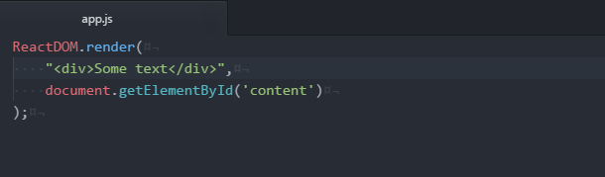
INTRODUCTION –Setup
In app.js

Slide 15
INTRODUCTION –Setup
Through online libraries
React => For react
React-DOM => is the communicator between React and DOM
Babel => To convert JSX into JS
Through npm
npm install react --save
npm install react-dom –save
npm install babel-cli –-save-dev
npm install babel-preset-react
To run on a server
npm install –g http-server
http-sever –p 5005

Slide 16
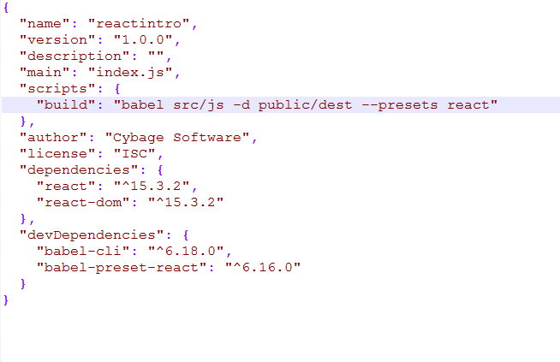
INTRODUCTION –Setup – using npm
In package.json

Slide 17
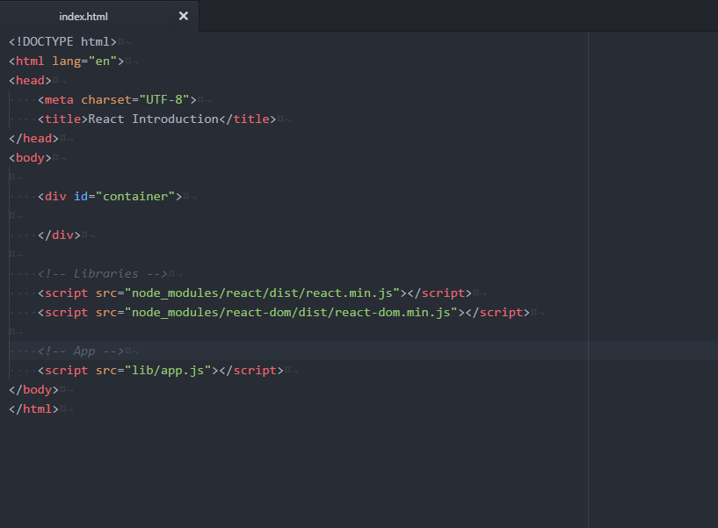
INTRODUCTION –Setup – using npm
In index.html

Slide 18


Slide 19

Thanks to pay your attention guys…

Slide 20
Components
When we call our render method, Component is the first argument.
Second one is the DOMNode where we want to mount

Slide 21
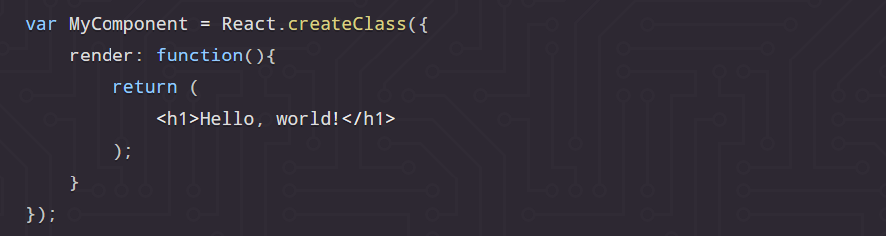
Components
We can use the createClass method to create custom component classes

Slide 22
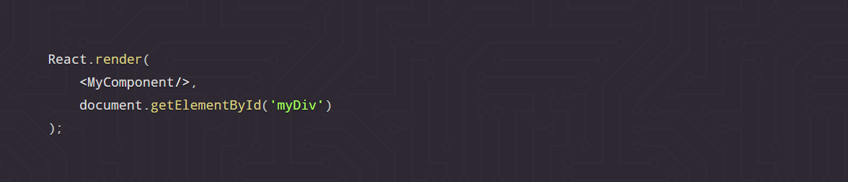
Components
After creating a class we can render it to our document

Slide 23
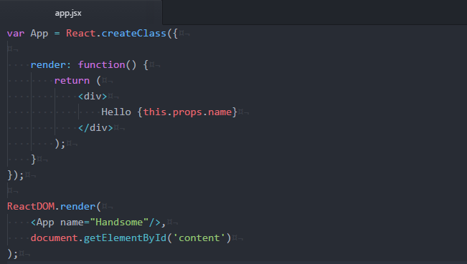
Props
we can add attributes called props
These attributes are available in our component as this.props
It can be used in our render method to render dynamic data

Slide 24
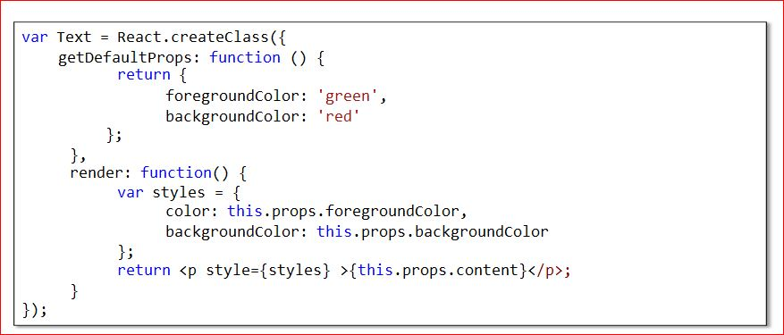
Props - getDefaultProps
This specifies the property values if they are not explicitly supplied

Slide 25
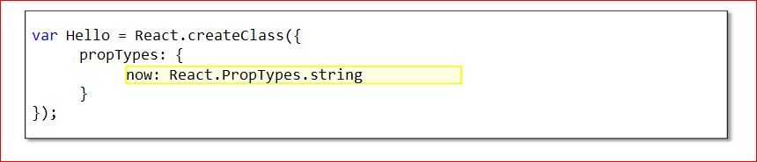
Props – Validating Properties
It validates properties by propTypes.
It supports validations for existing datatype or custom validation

Slide 26
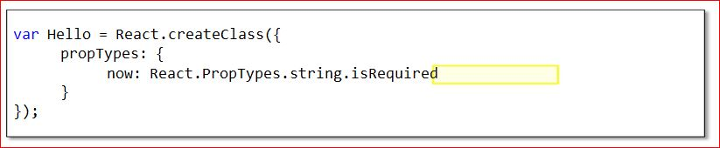
Props – Validating Properties
It validates properties by propTypes.
It supports validations for existing datatype or custom validation

Slide 27
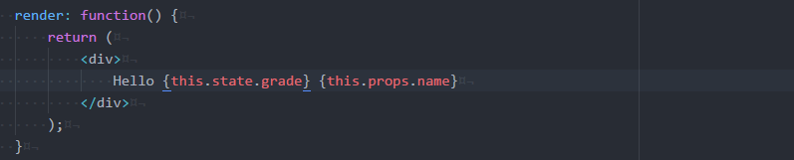
State
It helps to maintain or change the data within the component.
Component re-renders whenever we change the state.

Slide 28
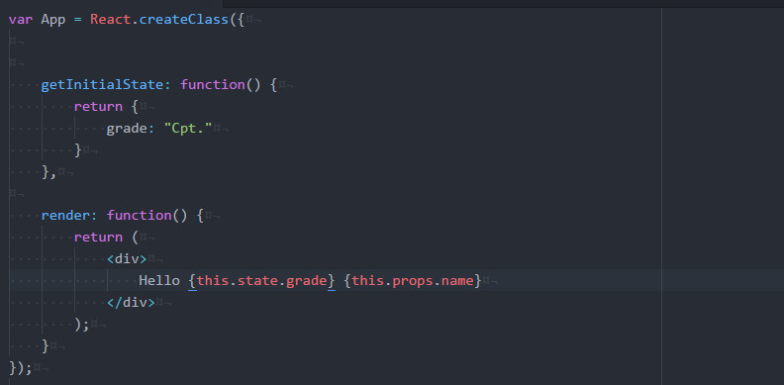
Specs - getInitialState
It allows the component to populate its initial state.

Slide 29
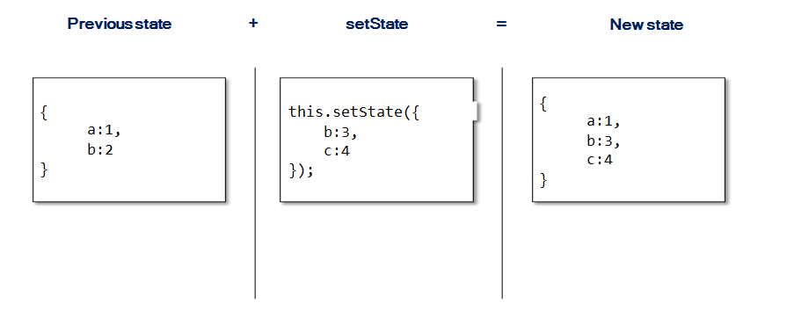
Specs - setState
This function is use to update the state of a component
It merges the new state with the old one.

Slide 30


Slide 31
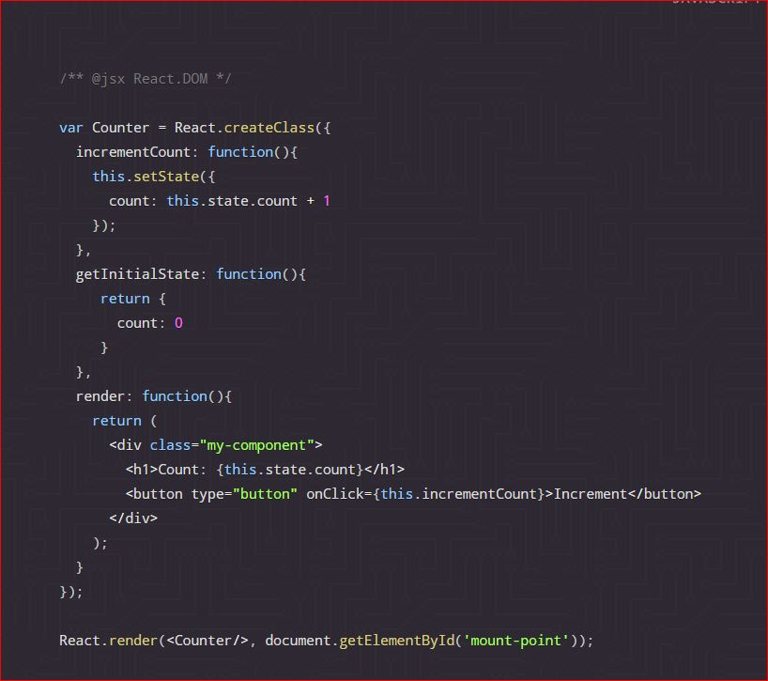
Events
Can attached as property of a component

Slide 32
Unidirectional Data Flow
In React, the application flow is uni-directional via state and props
So in the multiple hierarchy the component should manage this kind
of requirement using state
Your state should update itself while doing setState
If necessary the resulting value should be pass down to child component

Slide 33
Component Lifecycle
componentWillMount
componentDidMount
componentWillReceiveProps
shouldComponentUpdate
componentWillUpdate
componentDidUpdate
componentWillUnmount

Slide 34

Component Lifecycle - componentWillMount
When
Before initial render, both client and server
Why
Good spot to set initial state

Slide 35

Component Lifecycle - componentDidMount
When
After render
Why
Access DOM, integrate with frameworks, set timers, AJAX requests

Slide 36

Component Lifecycle - componentWillReceiveProps
When
When receiving new props. Not called on initial render
Why
Set state before a render

Slide 37

Component Lifecycle - componentWillUpdate
When
Imidiately before rendering when new props or state are being received
Not called on initial render
Why
Prepare for an update

Slide 38
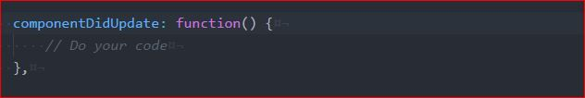
Component Lifecycle - componentDidUpdate
When
After component update to the DOM
Not called for the initial render
Why
Work with the DOM after as update

Slide 39

Component Lifecycle - componentWillUnmount
When
Immediately before component is removed from the DOM
Why
Cleanup

Slide 40
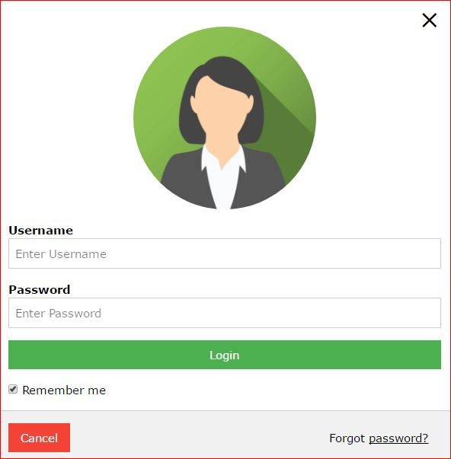
Assignment -1

Slide 41
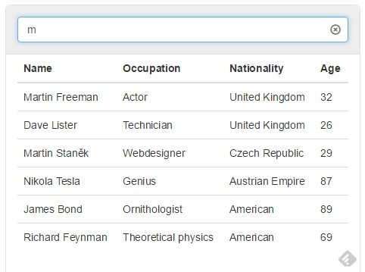
Assignment -2

Slide 42


Slide 43
Flux
Should I use flux ?
Why Flux ?
What is Flux ?

Slide 44
Should I use flux ?
If your application deals with dynamic data then yes
If your application is just static views that don't share state, and you never
save nor update data, then no,

Slide 45
Why Flux ?
This provides you a structured way of code
It handles Uni-Directional flow very well

Slide 46
What is Flux ?
Flux is a word made up to describe "one way" data flow with very specific
events and listeners
There's no official Flux library, but you'll need the Flux Dispatcher,
and any Javascript event library

Slide 47
Flux
Action: This is a helper method that facilitate passing data to dispatcher
Dispatcher: Receives actions and broadcasts payloads to registered
callbacks
3. Stores: Containers for application state & logic that have callbacks
registered to the dispatcher
4. Controller Views: React Components that grab the state from Stores and
pass it down via props to child components

Slide 48
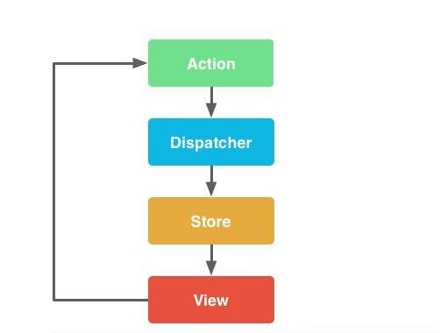
Flux Flow

Slide 49
Your view “Dispatch” “Actions”
A "dispatcher" is essentially an event system with some extra rules added
It broadcasts events and registers callbacks
There is only ever one, global dispatcher
You should use the Facebook Dispatcher Library. It's very easy to instantiate:
https://github.com/facebook/flux/blob/master/src/Dispatcher.js

Slide 50
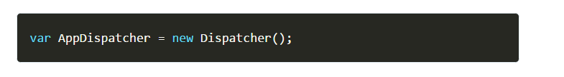

Your view “Dispatch” “Actions”
It's very easy to instantiate:
Let's say your application has a "new" button that adds an item to a list.

Slide 51
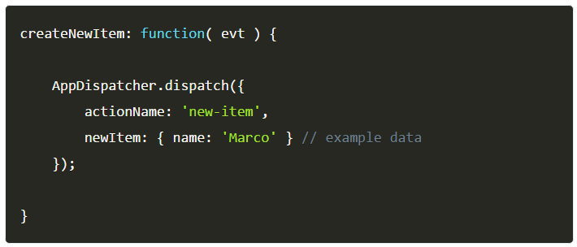
Your view “Dispatch” “Actions”
Your view dispatches a very specific "action", with the action name and
new item data
that describes what we want to do, and the data we need to do it.

Slide 52
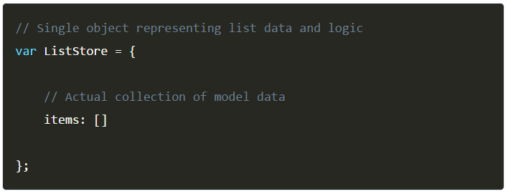
Your “Store” Responds to Dispatched Actions
Here we need a specific collection of logic and data for the list.
This describes our store. We'll call it a ListStore.
A store is a singleton, meaning you probably shouldn't declare it with new.

Slide 53
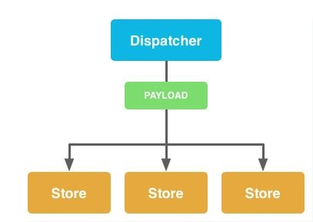
Flux – Dispatcher

Slide 54
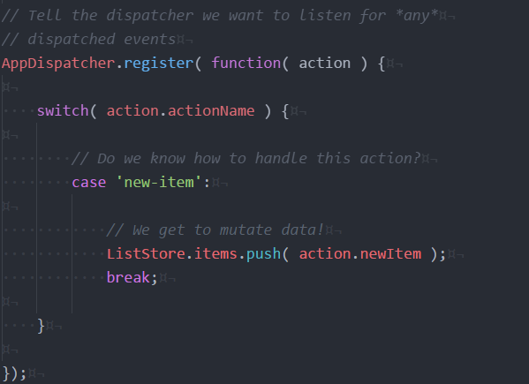
Your “Store” Responds to Dispatched Actions
Your store then responds to the dispatched action

Slide 55
Your “Store” Responds to Dispatched Actions
This is traditionally how Flux handles dispatch callbacks
Each payload contains an action name and data
A switch statement determines if the store should respond to the action,
and mutates data
Note:
A store is not a model. A store contains models
A store is the only thing in your application that knows how to update data.
This is the most important part of Flux.
The action we dispatched doesn't know how to add or remove items

Slide 56

Your store Emits a “Change” event
Now that your data is definitely changed, we need to tell the world.
Your store emits an event, but not using the dispatcher.
Let's give our store the ability to trigger events using MicroEvent.js
https://github.com/jeromeetienne/microevent.js/raw/master/microevent.js

Slide 57
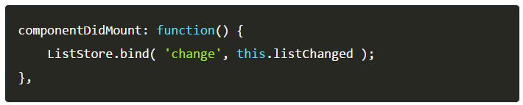
Your view respond to change event
Now we need to display the list.
Our view will completely re-render when the list changes
That's not a typo…
First, let's listen for the change event from our ListStore when the
component "mounts,"

Slide 58
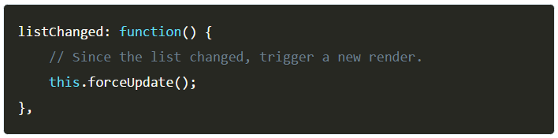
Your view respond to change event
For simplicity's sake, we'll just call forceUpdate.
which triggers a re-render.

Slide 59
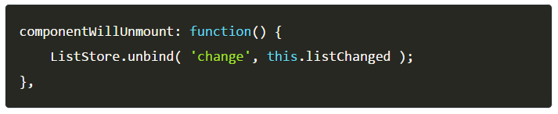
Your view respond to change event
Don't forget to clean up your event listeners when your
component "unmounts,"
which is when it goes back to hell

Slide 60
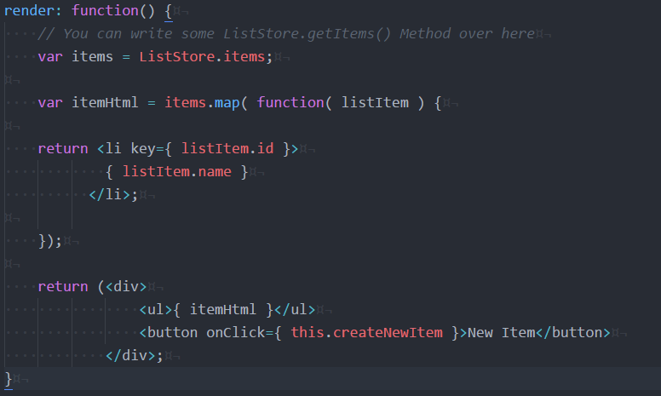
Finally the render method…

Slide 61
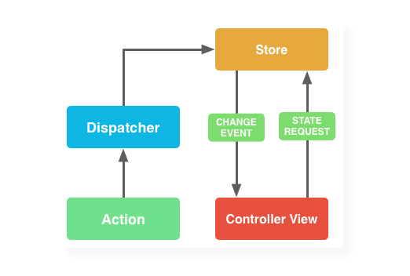
Flux

Slide 62
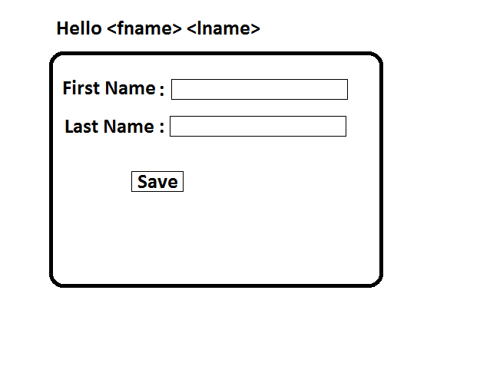
Assignment
1. Form – By clicking on Save Button it should change the name

Slide 63
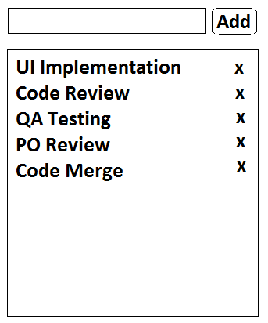
Assignment
2. To Do – There is a text box in which you can type your task and by clicking
on Add button it should be added to the list. And by clicking on (x) button
it should remove that task.

Slide 64


